Slide 1

Blockchain Logistics
Community
Connect | Collaborate | Create

Slide 2
Solution Architecture - Scope
Requirement:
Tracking logistic transaction between one retailer, two manufacturers each one tied up with a logistic provider.
Consortium:
1 Retailer, 2 Manufacturers and 2 Logistic Providers

Slide 3
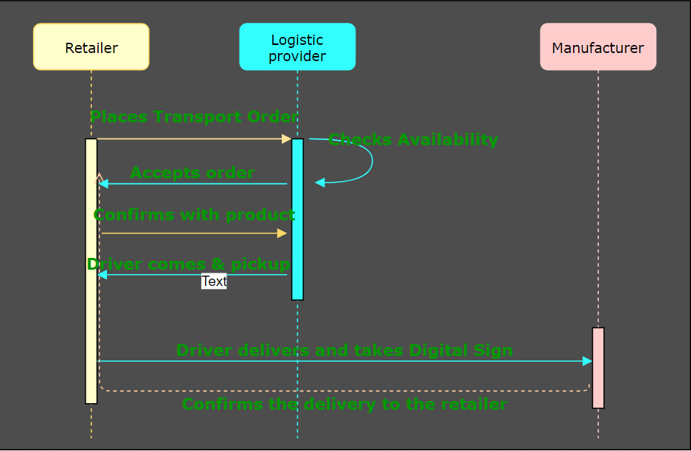
Solution Architecture - Sequence

Slide 4
Solution Architecture – Network Specs
S.No | Component | Qty | Category | Name
1 | Network | 1 | Network | Block Logistics
2 | Orgs | 3 | Participants | Logistics1, Logistics1, Retailer1 , Mfg1, Mfg2
3 | CA | 1 | MSP | Fabric-CA
4 | Channel | 1 | endorsement & State | BlockChannel1
5 | ChainCode | 2 | Logic | Retailer, Driver
6 | Users | 3 | End user and admin | adminNT, userL, userD, userC

Slide 5



Solution Architecture - Actors
Retailer
Manufacturer
Driver
Actor Attributes: Username, Full Name, Org

Slide 6
Solution Architecture - Assets - Attributes
OrganizationProfile : OrgName, OrgType, Address
UserProfile : UserName, Password, Private Key, Public Key
TransportRecord : TruckNum, DriverName, LogisticOrg, FromOrg,ToOrg, FromAddress, ToAddress, FromLocLat, FromLocLng, ToLocLat, ToLocLng, DeliveryLat, DeliveryLng, DeliveryDtTm, TransportStatus(Pickup, InTransit, Delivered)

Slide 7
Assets and Attributes
Manufacture:
Mfg Name
Mfg Id
Mobile Number
Email-Id
Address
Shipper Attributes:
Shp Name
Shp Id
Mobile Number
Email-Id
Address
Digital Signature
Retailer Attributes:
Rtl Name
Rtl Id
Mobile Number
Email-Id
Address
Digital Signature

Slide 8

Solution Architecture - Transactions
Fabric Network
Logistics Chain code
Admin
UI
Rest Gateway
Request: Logistics Profile

Slide 9
Fabric Network
Request: Manufacturer Profile
Logistics Chain code
Admin
UI
Rest Gateway

Slide 10
Fabric Network
Request: Retailer Profile
Logistics Chain code
Admin
UI
Rest Gateway

Slide 11
Solution Architecture - Chain codes
RetailerTransport:
DriverTransport
ManufTransport

Slide 12
Step1:
Shipper will Assign RWB Numbers (Serial number)
RWB Attribute:
RWB Serial numbers
Step 2:
Manufacture start booking for shipper
1.first he select RWB Number
2.He Assign RWB Number to Product or Item
RWB Product or RWB Item (Attribute):
Scan or type RWB number
Product Name
Product Type
HSN/SCN number
Product units
Size : L x W x H
3. Mfg selects Shipper
4. Mfg Assign
Pickup Date
Pickup Location
Drop Date
Drop Location
5. Mfg selects Retailer
Then Clicking on Booking Button
After Completed Status should be Booking Assign

Slide 13
Step 3
1.Shipper Received Status of New Booking done from Manufacture or Retailer
2.shipper will Accept or Reject
If Reject
The Booking will Cancel and pop up the status to manufacture or retailer that your Booking is canceled
Transaction to stop
If Accepted
Shipper will select RWB Number
Shipper will Assign Driver & (Pickup date, Pickup Location, Drop date & Drop Location)
Shipper will Assign Vehicle
Shipper Confirm
After Shipper confirm Status change to Assigned
Driver Attribute: Vehicle Attribute:
Driver name Vehicle name
Driver code Make & Model
Driver Image Vehicle Image
Mobile number License Plate No
Email Id Vehicle Status
Address
Digital Signature

Slide 14
Step 4:
Driver Will receive POP of Job Assigned
Driver Accept it
He will live to Collect RWB product From Manufacture - Status (on the way)
After reaching Pickup Location he Load the RWB Products – Status (Shipment Loaded )
He will collect Private Key or Digital Signature of Manufacture for Authentication
After Manufacture Authentication Driver will Authenticate with Private Key or Digital Signature – Status (In Transit)
He will Reach Drop Location and unload the RWB Product – Status (Shipment Unloaded)
Driver will Authenticate with Private Key or Digital Signature
After Driver Retailer will Authenticate with Private Key or Digital Signature – Status (Delivered)
After that Delivered Status will go to Manufacture, Shipper, Retailer i.e, RWB Product is Delivered
Similar Status as of Manufacture is seen by Shipper and Retailer
Step 5:
Shipper verify and confirm for block Creation

Slide 15
Solution Architecture – Technology Stack
S.No | Tool / Framework | Category | Solution Folder
1 | Hyperledger Fabric | Blockchain OS | HLFabric
2 | Chaincode Lang | Go Lang | HLFabric
3 | Configuration type | SHIM type | HLFabric
4 | StateDB | CouchDB(Default) | HLFabric
4 | LedgerDB | GoLevelDB (Default) | HLFabric
5 | Fabric SDK | Node SDK | AppServer
6 | Backend Server Platform | NodeJS | AppServer
7 | REST Engine | ExpressJS | AppServer
8 | Authentication | JWT | AppServer
9 | Front End | Angular, Bootstrap, Android | AppClient

Slide 16
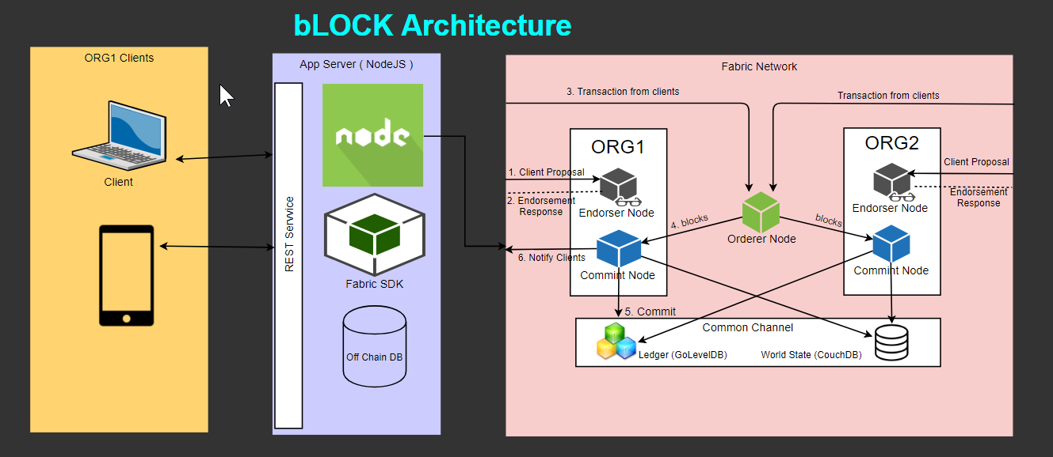
Solution Architecture - Logical

Slide 17


